Slide 1
Mechanical Waves
The mechanical waves discussed require
some source of disturbance,
a medium that can be disturbed, and
some physical connection through which adjacent portions of the medium can influence each other.
Mechanical waves are disturbances in matter that carry energy from one place to another through medium.
Medium can be a solid, liquid, or gas
Some waves can travel through space…with no medium! e.g Electromagnetic waves

Slide 2
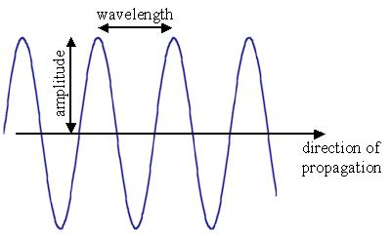
Types of Mechanical Waves
Transverse:
A wave that causes the medium to vibrate at right angles to the direction of the wave

Slide 3
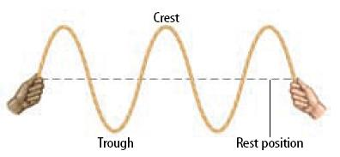
Transverse Waves
In a transverse wave the matter in the wave moves up and down at a right angle to the direction of the wave

Slide 4
Longitudinal:
A wave in which the vibration of the medium is parallel to the direction the wave travels

Slide 5
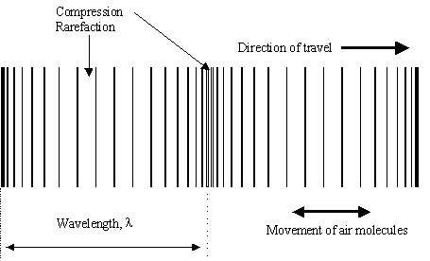
Parts of a longitudinal wave:

Slide 6
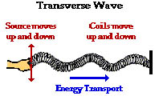
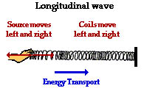
Remember!
A wave doesn’t move the medium…it’s just energy traveling through the medium!

Slide 7
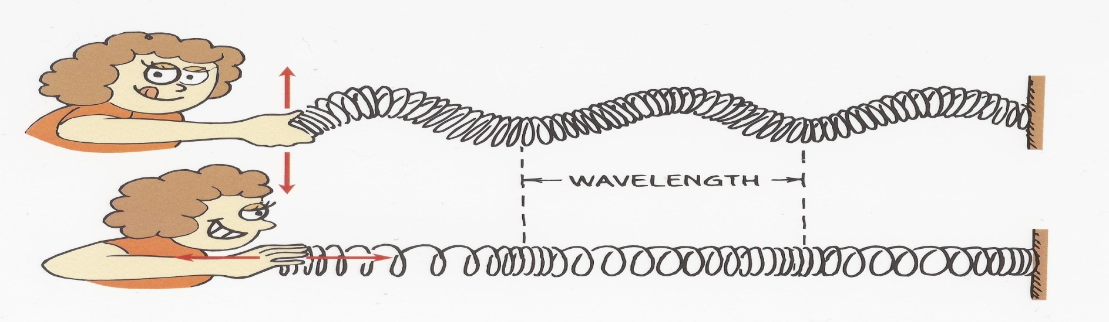
Transverse and Longitudinal Wave

Slide 8
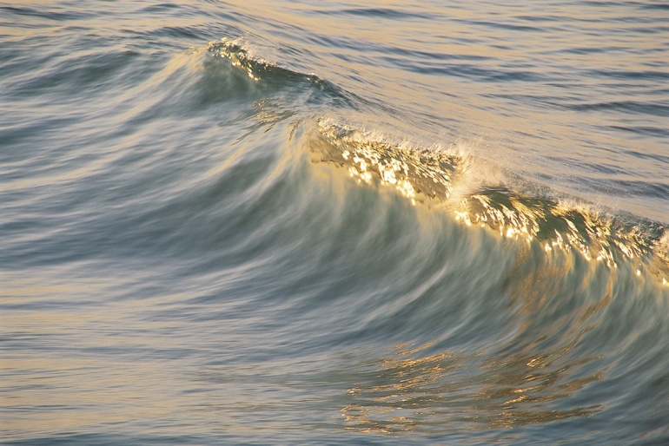
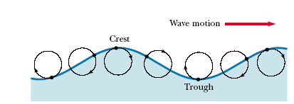
Combination of transverse and longitudinal
The motion of water molecules on
the surface of deep water in which a
wave is propagating is a combination of transverse and longitudinal displacements, with the result that molecules at the surface move in nearly circular paths. Each molecule is displaced both horizontally and vertically from its equilibrium position.

Slide 9
Combination of transverse and longitudinal
surface of deep water

Slide 10
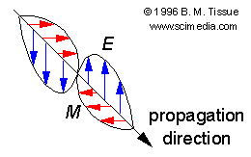
Light is a Transverse Waves although it is not mechanical wave
Energy is perpendicular to direction of motion
Moving photon creates electric & magnetic field
Light has BOTH Electric & Magnetic fields at right angles and perpendicular to the direction of propagation of wave.

Slide 11
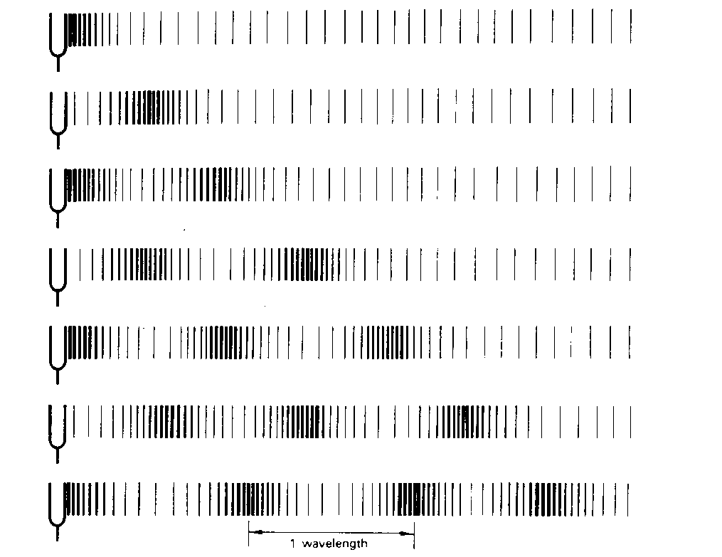
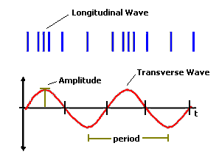
Sound Waves
Sound waves are Longitudinal wave.

Slide 12
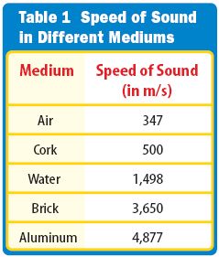
Sound travels through different media.
We hear sound which usually travels through air. Sound travels through other media as well, such as water and various solids.
Sound travels different speeds in different media. Sound typically travels faster in a solid that a liquid and faster in a liquid than a gas.
The denser the medium, the faster sound will travel.
The higher the temperature, the faster the particles of the medium will move and the faster the particles will carry the sound.

Slide 13
Infrasonic and Ultrasonic
A healthy human ear can hear frequencies in the range of 20 Hz to 20,000 Hz. Humans cannot hear below 20 Hz. Sounds below this frequency are termed infrasonic.
Sounds above 20,000 Hz are termed ultrasonic. Some animals, such as dogs, can hear frequencies in this range in which humans cannot hear.

Slide 14
Waves transfer energy without transferring matter.
Frequency= waves/time

Slide 15
Speed of Sound
Medium velocity m/sec
air (20 C) 343
air (0 C) 331
water (25 C) 1493
sea water 1533
diamond 12000
iron 5130
copper 3560
glass 5640

Slide 16
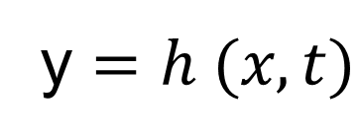
Wave on a string
To completely describe a wave on a string, we need a function
that gives the shape of the wave.
Where y is the transverse displacement of any string element
as a function h of the time t and the position x of the element
along the string.
h can be a sine or cosine function

Slide 17
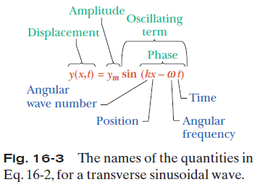
Wave Variables

Slide 18




Wave Variables
The amplitude y_{m} of a wave is the magnitude of the maximum displacement of the elements from their equilibrium positions as the
wave passes through them.
The phase of the wave is the argument (kx –ωt) of the sine function. As the wave sweeps through a string element at a particular position x, the phase changes linearly with time t.
The wavelength λ of a wave is the distance parallel to the direction of the wave’s
travel between repetitions of the shape of the wave (or wave shape). It is related to the angular wave number, k, by
:
The period of oscillation T of a wave is the time for an element to move through one full oscillation. It is related to the angular frequency, ω, by
The frequency f of a wave is defined as 1/T and is related to the angular frequency ω by
A phase constant φ in the wave function:
y =y_{m} sin(kx –ωt+ φ). The value of φ can be chosen so that the function gives some other displacement and slope at x = 0 when t = 0.
Notes:
y = ym sinKx (t=0) , ym sin kx = ym sink(x1+ʎ) ; x=x1 x = x1+ʎ
ym sinkx = ym sin(kx +ʎk) b/s for each wavelength angle change 2pi , ʎk=2pi

Slide 19
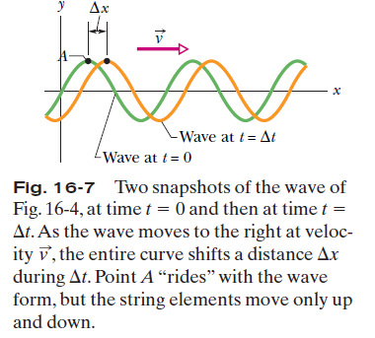
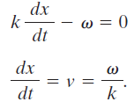

The Speed of a Traveling Wave

Slide 20

Example, Transverse Wave

Slide 21
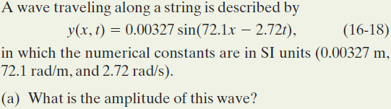
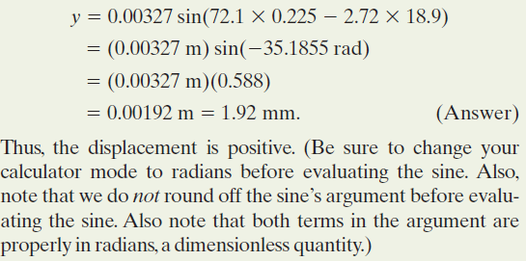
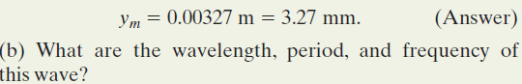
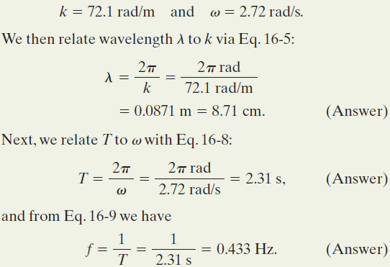

Example, Transverse Wave

Slide 22
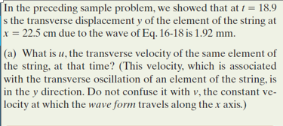
Example, Transverse Wave, Transverse Velocity, and Acceleration

Slide 23
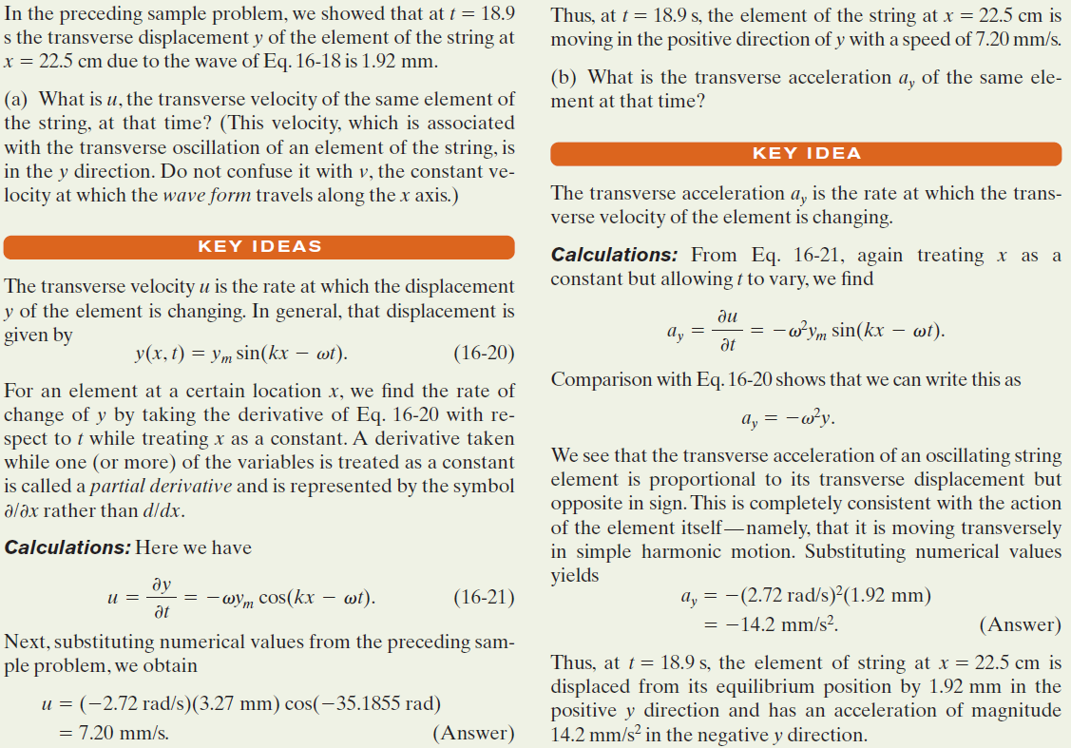
Example, Transverse Wave, Transverse Velocity, and Acceleration

Slide 24

The Wave Equation
A travelling wave is always in the following form:
Such functions are solutions of the wave equation:
# It is a linear partial differential equation; when y₁ and y₂ are solutions, any linear combination of y₁ and y₂ (like ay₁+by₂) is also a solution.

Slide 25
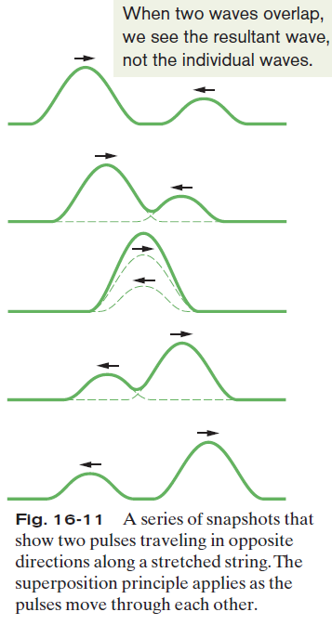

The Superposition of Waves
Overlapping waves algebraically add to produce a resultant wave (or net wave).
Overlapping waves do not in any way alter the travel of each other.
They interfere but do not interact.
# The principle of linear superposition is valid only when the amplitude is small.

Slide 26



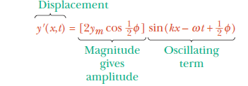
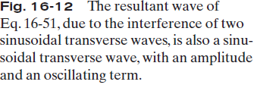
Interference of Waves
If two sinusoidal waves of the same amplitude and wavelength travel in the same direction along a stretched string, they interfere to produce a resultant sinusoidal wave traveling in that direction.

Slide 27
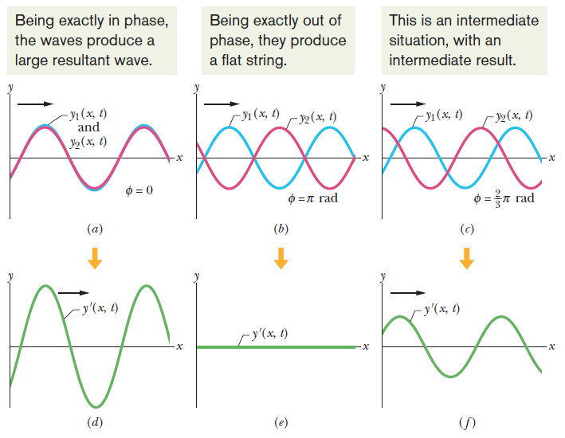
Interference of Waves

Slide 28
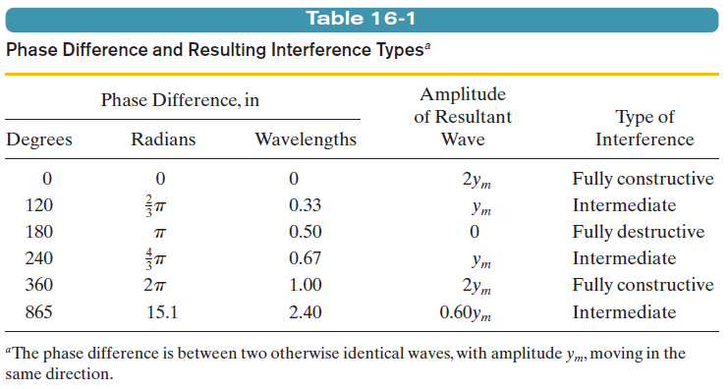
Interference of Waves

Slide 29
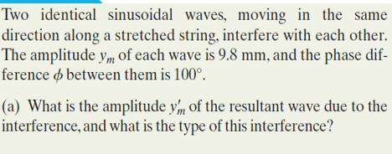
Example, Transverse Wave:

Slide 30
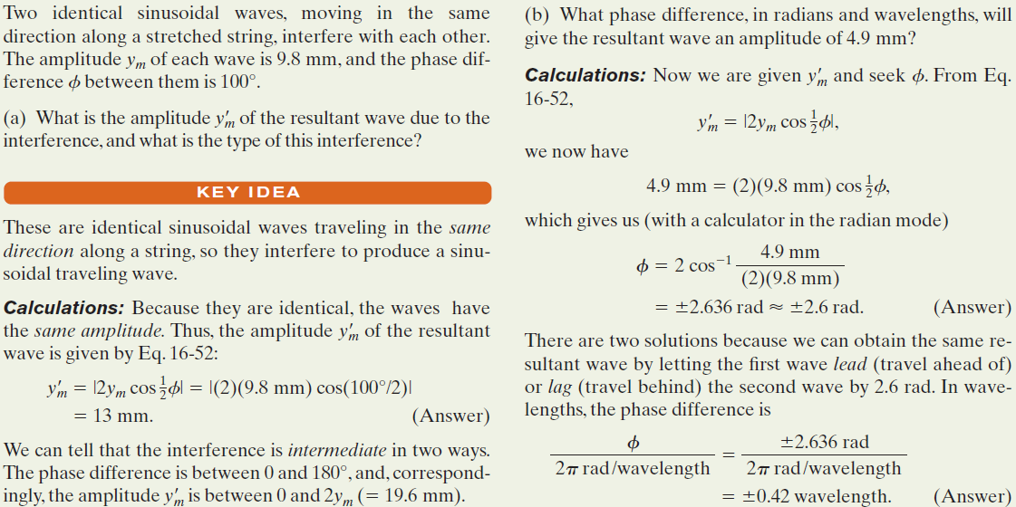
Example, Transverse Wave:

